Slide 1
Live Sperm
Identifying Viability of Immotile Sperm at One Glance:
Sperm Viability Classifier Powered by Deep Learning
1 1 2 1 3
Aojun Jiang, Jiaqi Wang, Huan Zhao, Zhuoran Zhang and Yu Sun
1
The Chinese University of Hong Kong (Shenzhen), Shenzhen, China
Luohu People's Hospital, Shenzhen, China
University of Toronto, Toronto, Canada
2
3

Slide 2
Is it alive?
Notes:
开始时间

Slide 3
Testing Viability of Immotile Sperm

Slide 4
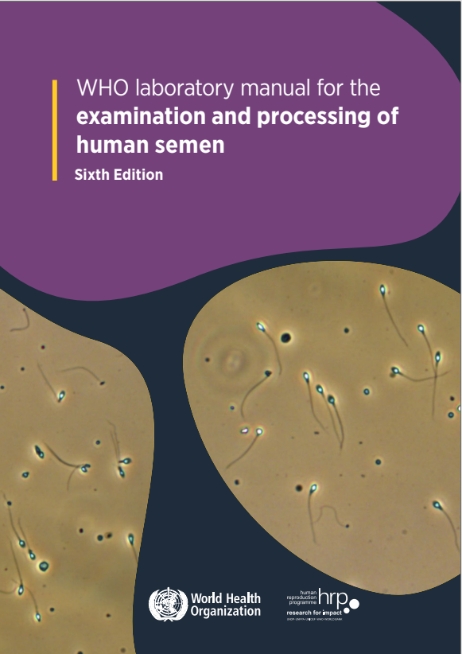
Testing Viability of Immotile Sperm
ICSI Treatment: Picking Live Sperm for NOA Patients
Hypo-Osmotic Swelling Test
Diagnosis: Asthenozoospermia
NOA: Non-Obstructive Azoospermia

Slide 5
ICSI Treatment: Picking Live Sperm for NOA Patients
Hypo-Osmotic Swelling Test
Hypo-Osmotic
Solution

Slide 6
ICSI Treatment: Picking Live Sperm for NOA Patients
Hypo-Osmotic Swelling Test
Live
Live
Dead
Live
Dead
Hypo-Osmotic
Solution
After A Period of Time

Slide 7
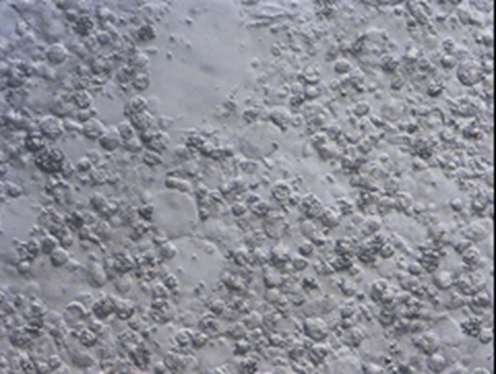
ICSI Treatment: Picking Live Sperm for NOA Patients
Surgical Sperm Retrieval
TESA
TESE
PESA
MESE
Tedious
Repeated
Cycles
Failed to Find A Viable Sperm
Dead
Hypo-Osmotic
Solution
Hypo-Osmotic
Solution

Slide 8
Testing Viability of Immotile Sperm
ICSI Treatment: Picking Live Sperm for NOA Patients
Hypo-Osmotic Swelling Test
Diagnosis: Asthenozoospermia
Eosin–Nigrosin Test

Slide 9
Diagnosis: Asthenozoospermia
“In samples with poor motility, the viability test is important to
discriminate between immotile dead sperm and immotile live sperm. ”
Performing viability tests are recommended if fewer than 25% of sperm are motile.

Slide 10
Diagnosis: Asthenozoospermia
Eosin–Nigrosin Test
Eosin–Nigrosin
Solution

Slide 11
Diagnosis: Asthenozoospermia
Eosin–Nigrosin Test
Dead
Live
Dead
Live
Eosin–Nigrosin
Solution
Dead
After A Period of Time

Slide 12
Cell Viability Tests in Laboratory Development

Slide 13
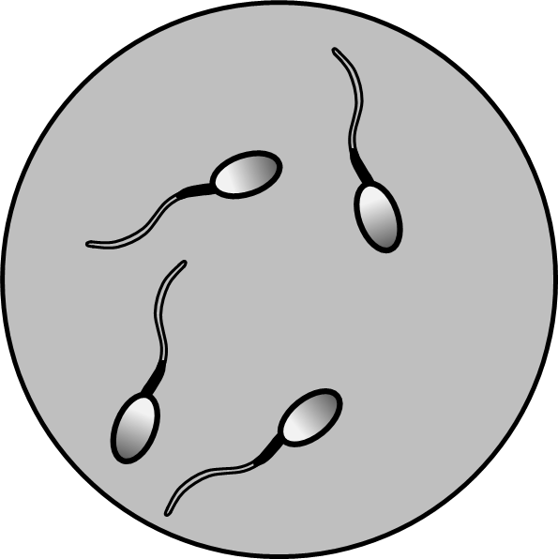
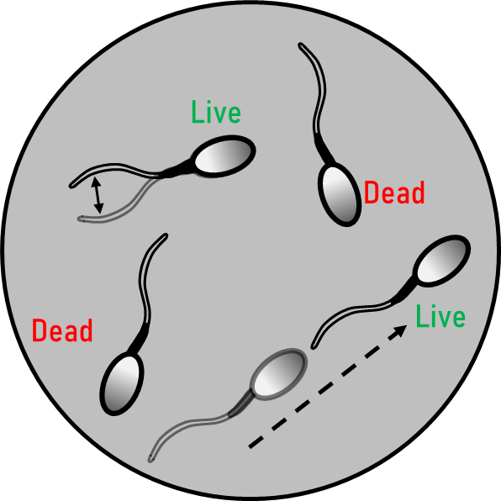
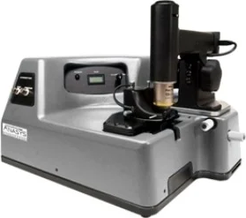
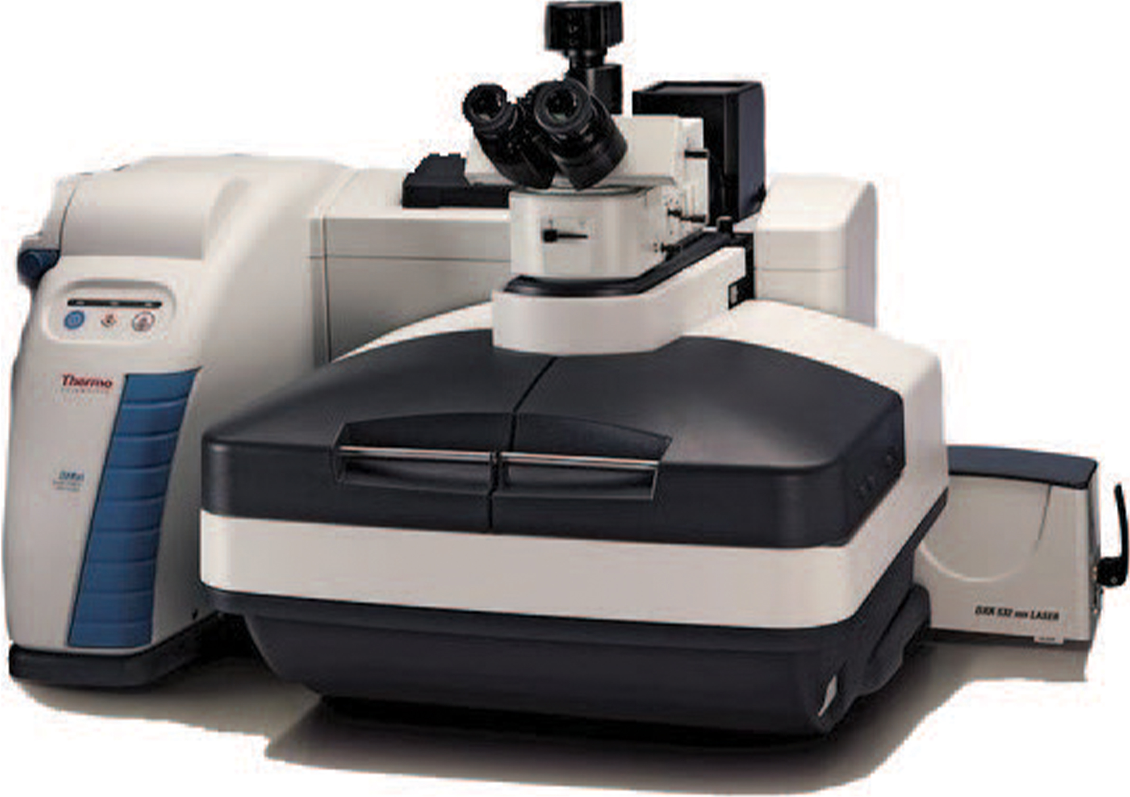
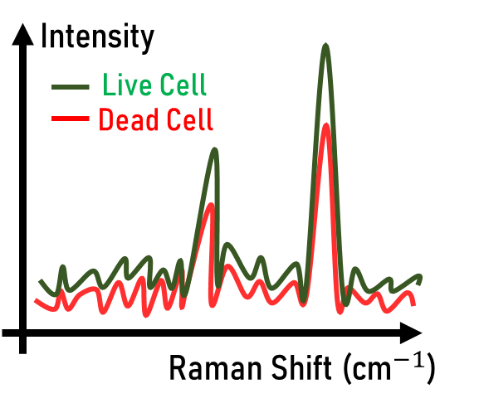
Cell Viability Tests in Laboratory Development
Activating Substances
Pentoxifylline
Related Study:
Kovacic et. al., 2006
Membrane
Stiffness
Image Source: Bruker
Atomic Force
Microscopy
Related Study:
Nikolaev et. al., 2014
Live Cell
Dead Cell
Raman Spectroscopy
Related Study:
Li et. al., 2019
Image Source: Thermo Scientific

Slide 14
Cell Viability Tests in Laboratory Development
Activating Substances
Pentoxifylline
Related Study:
Kovacic et. al., 2006
Membrane
Stiffness
Image Source: Bruker
Atomic Force
Microscopy
Related Study:
Nikolaev et. al., 2014
Live Cell
Dead Cell
Raman Spectroscopy
Related Study:
Li et. al., 2019
Image Source: Thermo Scientific

Slide 15
Cell Viability Tests in Laboratory Development
Activating Substances
Pentoxifylline
Related Study:
Kovacic et. al., 2006
Membrane
Stiffness
Image Source: Bruker
Atomic Force
Microscopy
Related Study:
Nikolaev et. al., 2014
Live Cell
Dead Cell
Raman Spectroscopy
Related Study:
Li et. al., 2019
Image Source: Thermo Scientific

Slide 16
Cell Viability Tests in Laboratory Development
Activating Substances
Pentoxifylline
Related Study:
Kovacic et. al., 2006
Membrane
Stiffness
Image Source: Bruker
Atomic Force
Microscopy
Related Study:
Nikolaev et. al., 2014
Live Cell
Dead Cell
Raman Spectroscopy
Related Study:
Li et. al., 2019
Image Source: Thermo Scientific

Slide 17
Motile Sperm
Immotile Sperm
At One Glance
At One Glance?

Slide 18
Is it possible to identify the viability of an immotile sperm at one glance?

Slide 19
Hypothesis：Microscopic images of sperm cells contain viability information

Slide 20
Vision Transformer
Attention Based Deep Learning Model
Notes:
后面的图加动画过渡

Slide 21
Vision Transformer
Attention Based Deep Learning Model
Notes:
后面的图加动画过渡

Slide 22
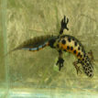
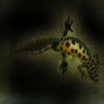
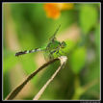
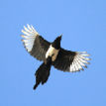
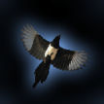
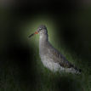
Vision Transformer
Attention Based Deep Learning Model
Notes:
后面的图加动画过渡

Slide 23
Data Collection
Vision Transformer Model Training
Testing and Validation
Dataset Collection
Model Training
Blind Testing

Slide 24
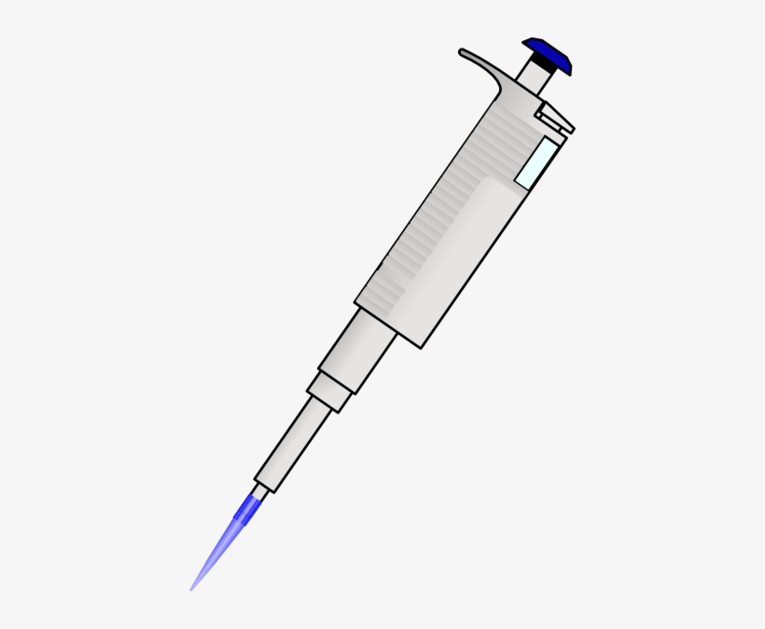
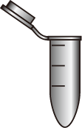
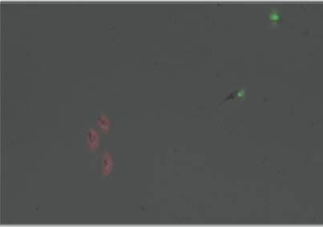
Live Immotile Sperm (Total 658 sperm)
…
…
Brightfield
…
…
…
…
…
Dead:
Propidium Iodide
…
SYBR14 Solution
10 minutes
Dead Immotile Sperm (Total 813 sperm)
37°C Water-bath
Live:SYBR14
Fluorescence-Red Filter
…
Diluted Semen Sample
(From 15 volunteers)
Fluorescence
Microscopy
…
Propidium Iodide
Solution
…
…
…
…
…
…
Fluorescence-Green Filter
Training : Validation = 80% : 20%
Dataset Collection
Model Training
Blind Testing
Notes:
不动的精子画X在外面 框住

Slide 25
Data Collection
Vision Transformer Model Training
Testing and Validation
Dataset Collection
Model Training
Blind Testing

Slide 26
L x
Transformer Encoder
Embedded
Patches
Norm
Multi-Head
Attention
Norm
MLP
Vision Transformer Model
Linear Projection of
Flattened Patches
Transformer Layer
Transformer
Encoder
Dead Sperm
Ground Truth Labels
MLP Head
Live
Sperm
Dataset Collection
Model Training
Blind Testing

Slide 27
Dead Sperm
Ground Truth Labels
Vision Transformer Model
Live
Sperm
Dataset Collection
Model Training
Blind Testing

Slide 28
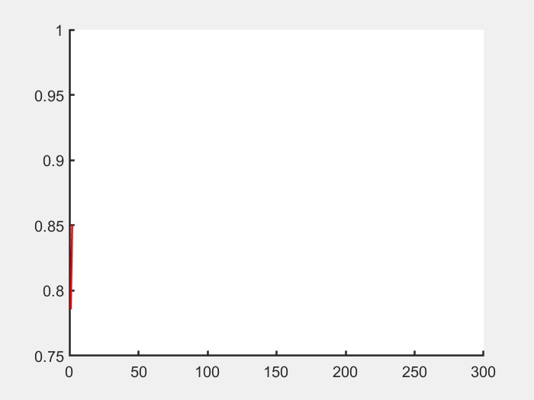
Training Accuracy
Higher
Attention
Less
Attention
Epoch
Dataset Collection
Model Training
Blind Testing

Slide 29
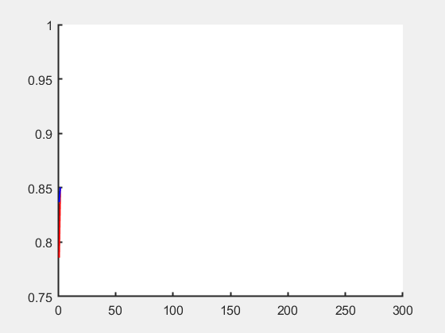
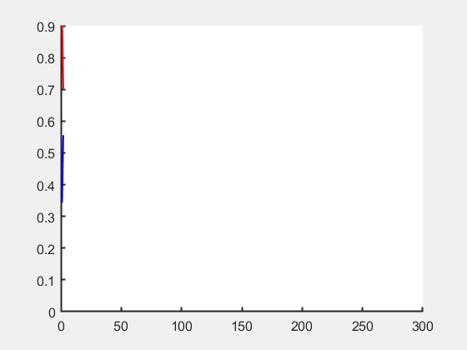
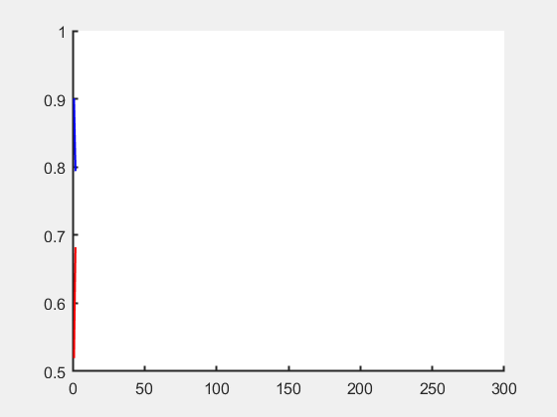
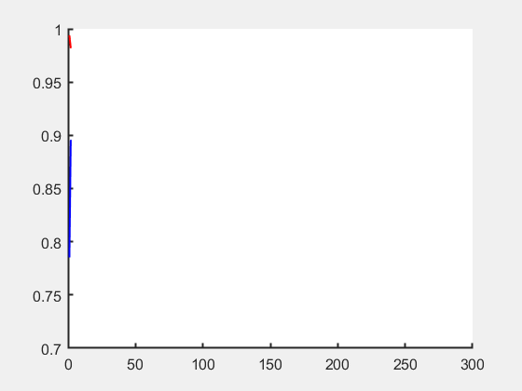
Accuracy
Loss
Training
Training
Validation
Validation
Recall
Specificity
Training
Time
Dataset Collection
Model Training
Blind Testing

Slide 30
10 New Samples
For Blind Testing
Reproductive Medicine Center
Dataset Collection
Model Training
Blind Testing

Slide 31
New Samples
Sperm Images
Ground Truth
Vision Transformer
Model
Prediction
Result
Dataset Collection
Model Training
Blind Testing

Slide 32
Dataset Collection
Model Training
Blind Testing

Slide 33
Dataset Collection
Model Training
Blind Testing

Slide 34
Model Prediction
Ground Truth
Dataset Collection
Model Training
Blind Testing

Slide 35
Model Performance
Confusion Matrix |  | Ground Truth
 |  | Live | Dead
Classifier Prediction | Live | 127 | 11
 | Dead | 4 | 152
Precision | Accuracy | Recall | Specificity | Total Images
92.0% | 94.9% | 97.0% | 93.3% | 294
Dataset Collection
Model Training
Blind Testing

Slide 36
What Details Does The AI Model Pay Most Attention To?
Opening the Black Box

Slide 37
Dataset Collection
Model Training
Blind Testing

Slide 38
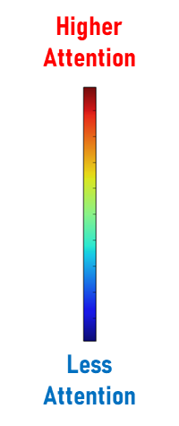
Dataset Collection
Model Training
Blind Testing

Slide 39
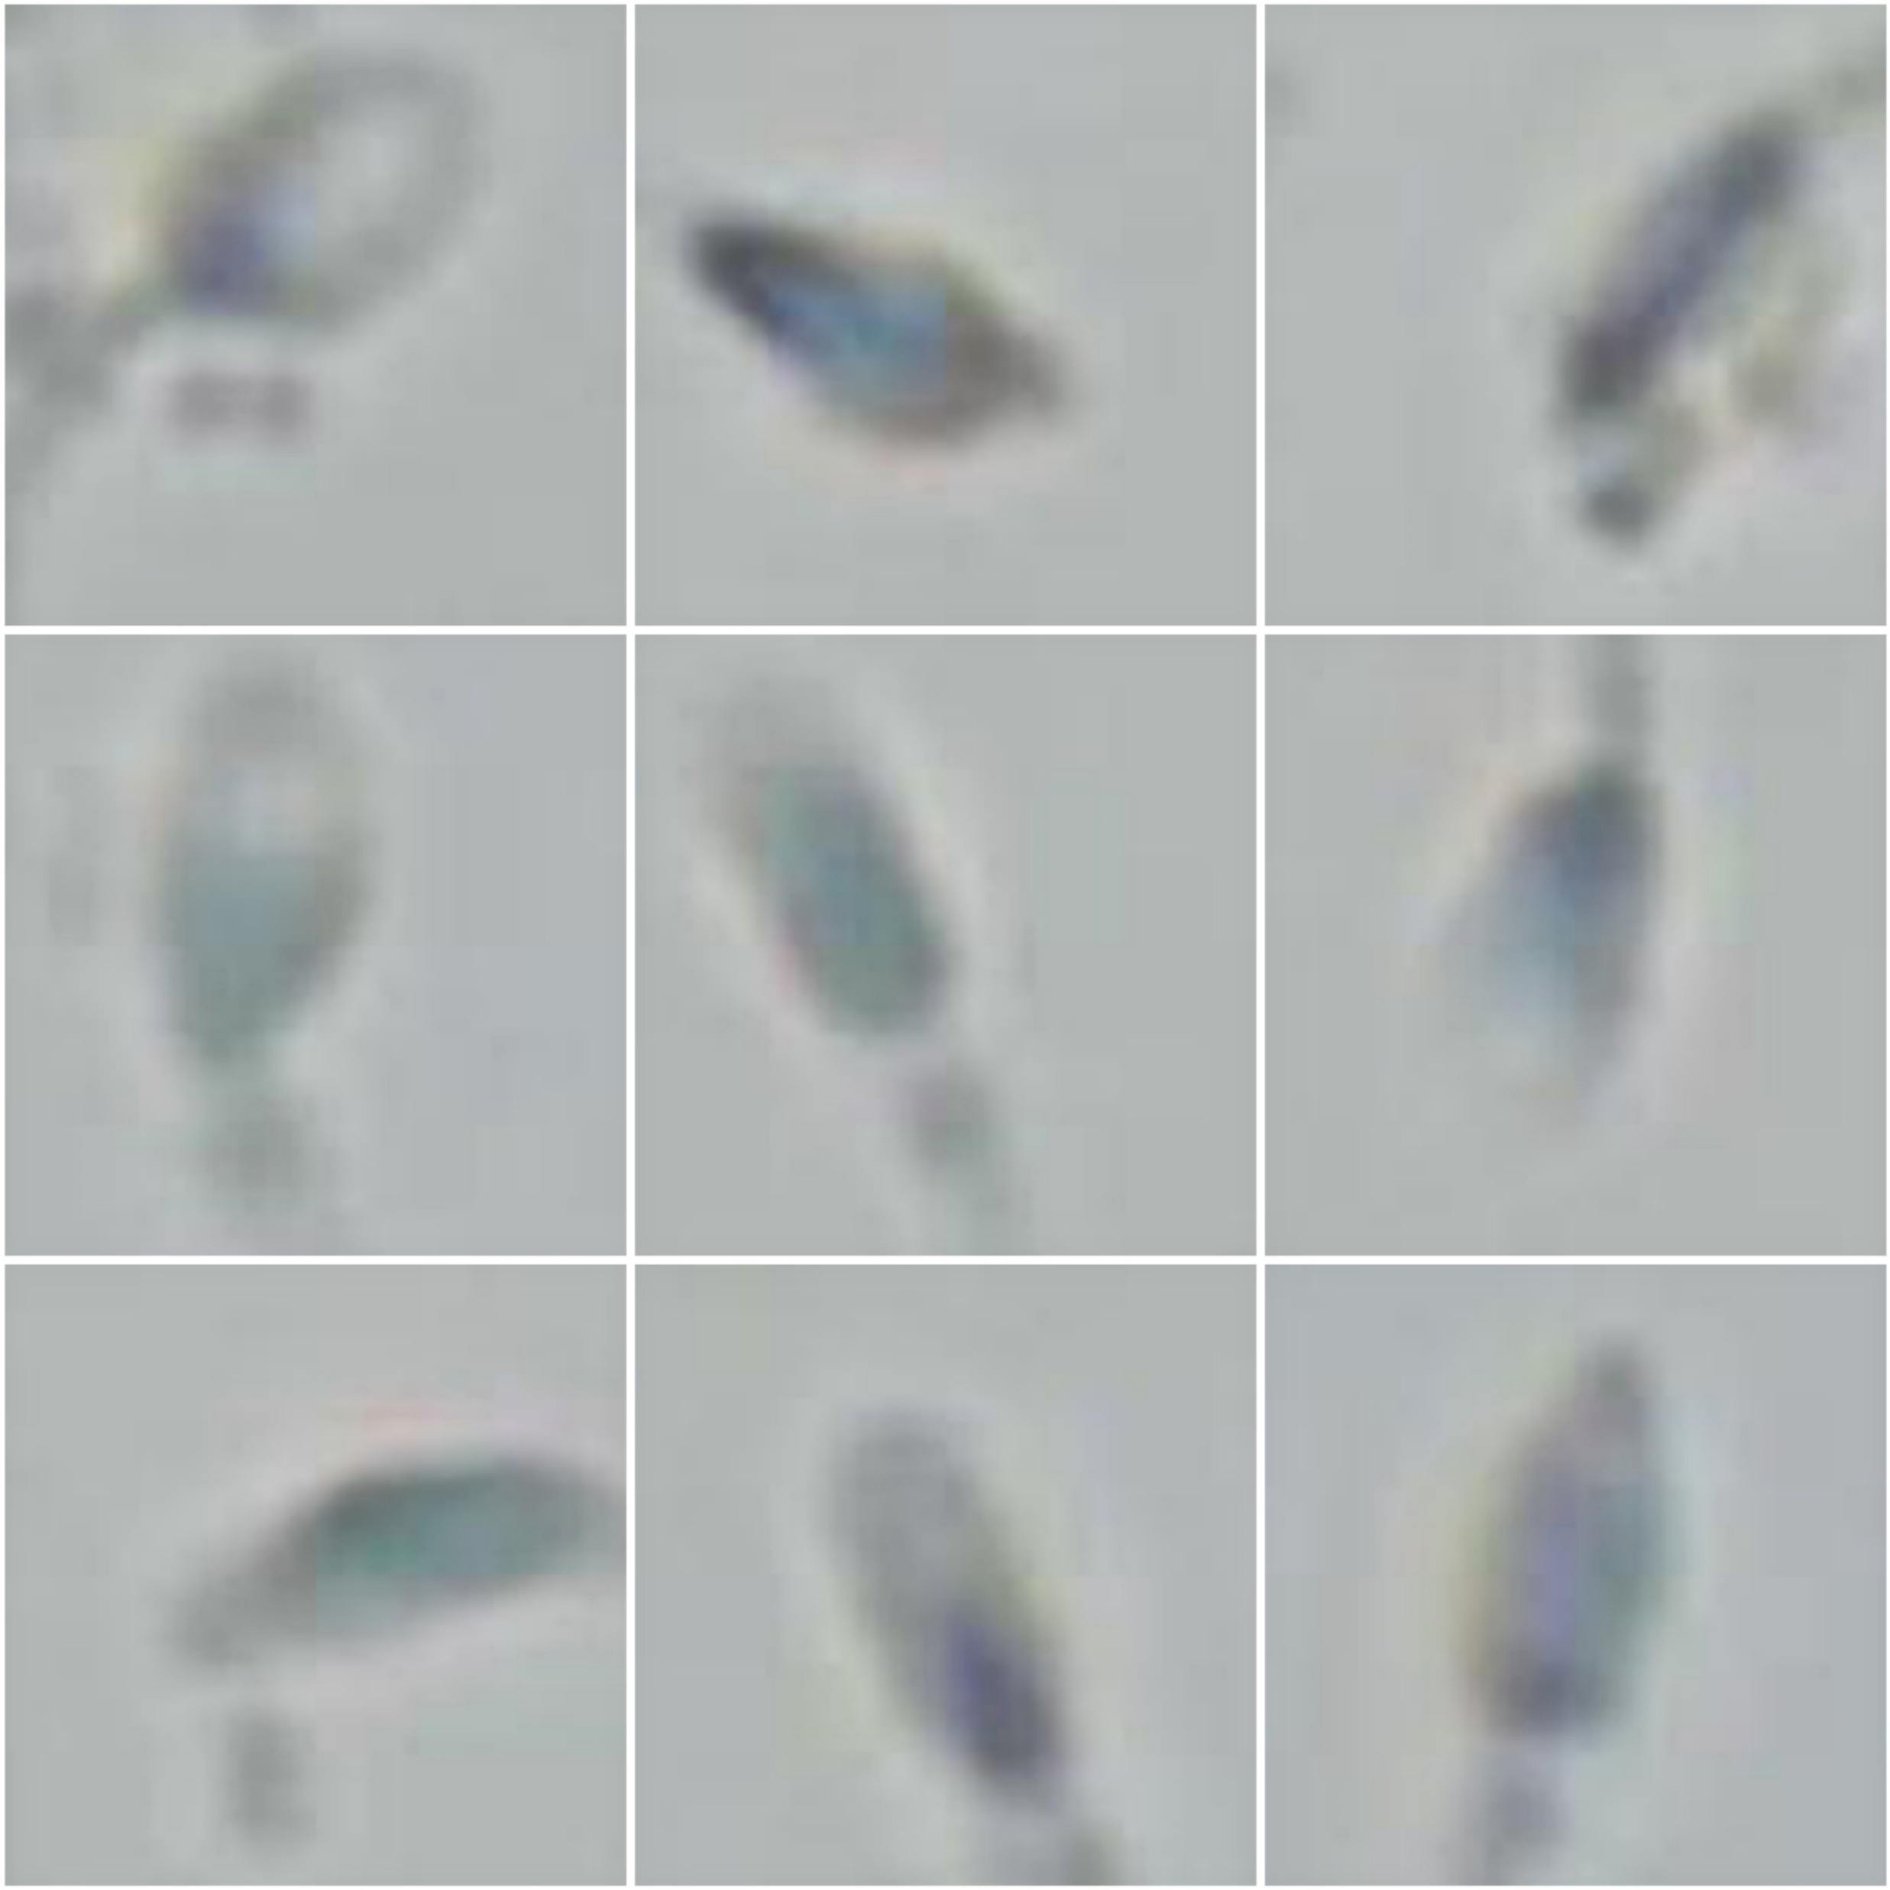
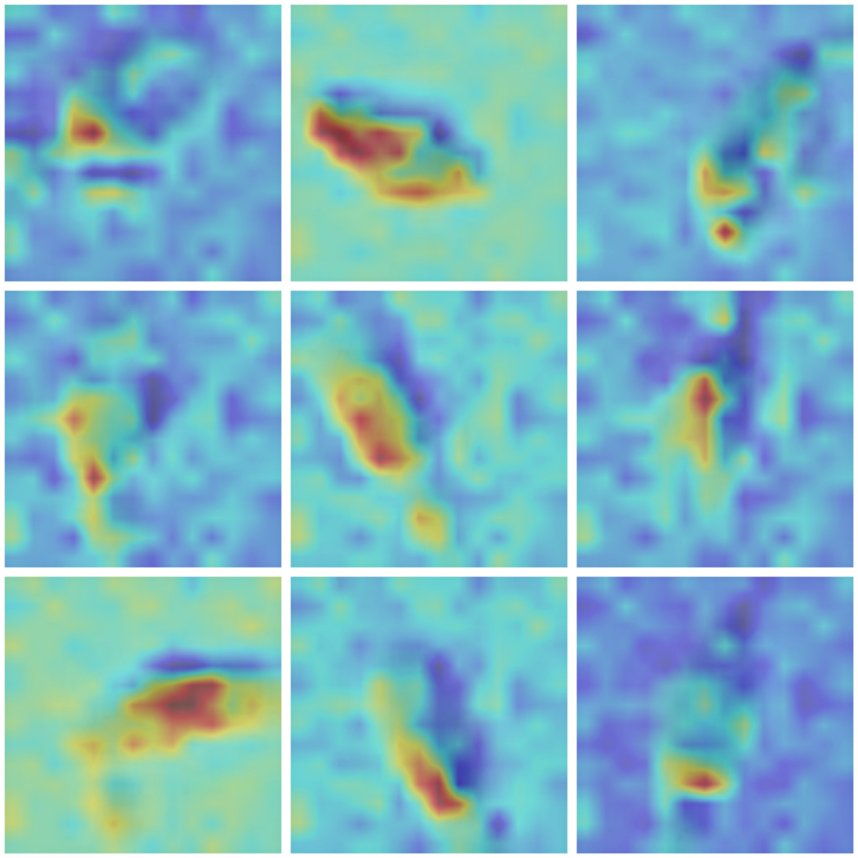
AI Model Pays More Attention to the Nucleus
All Dead Sperm
Higher
Attention
Less
Attention
Dataset Collection
Model Training
Blind Testing

Slide 40
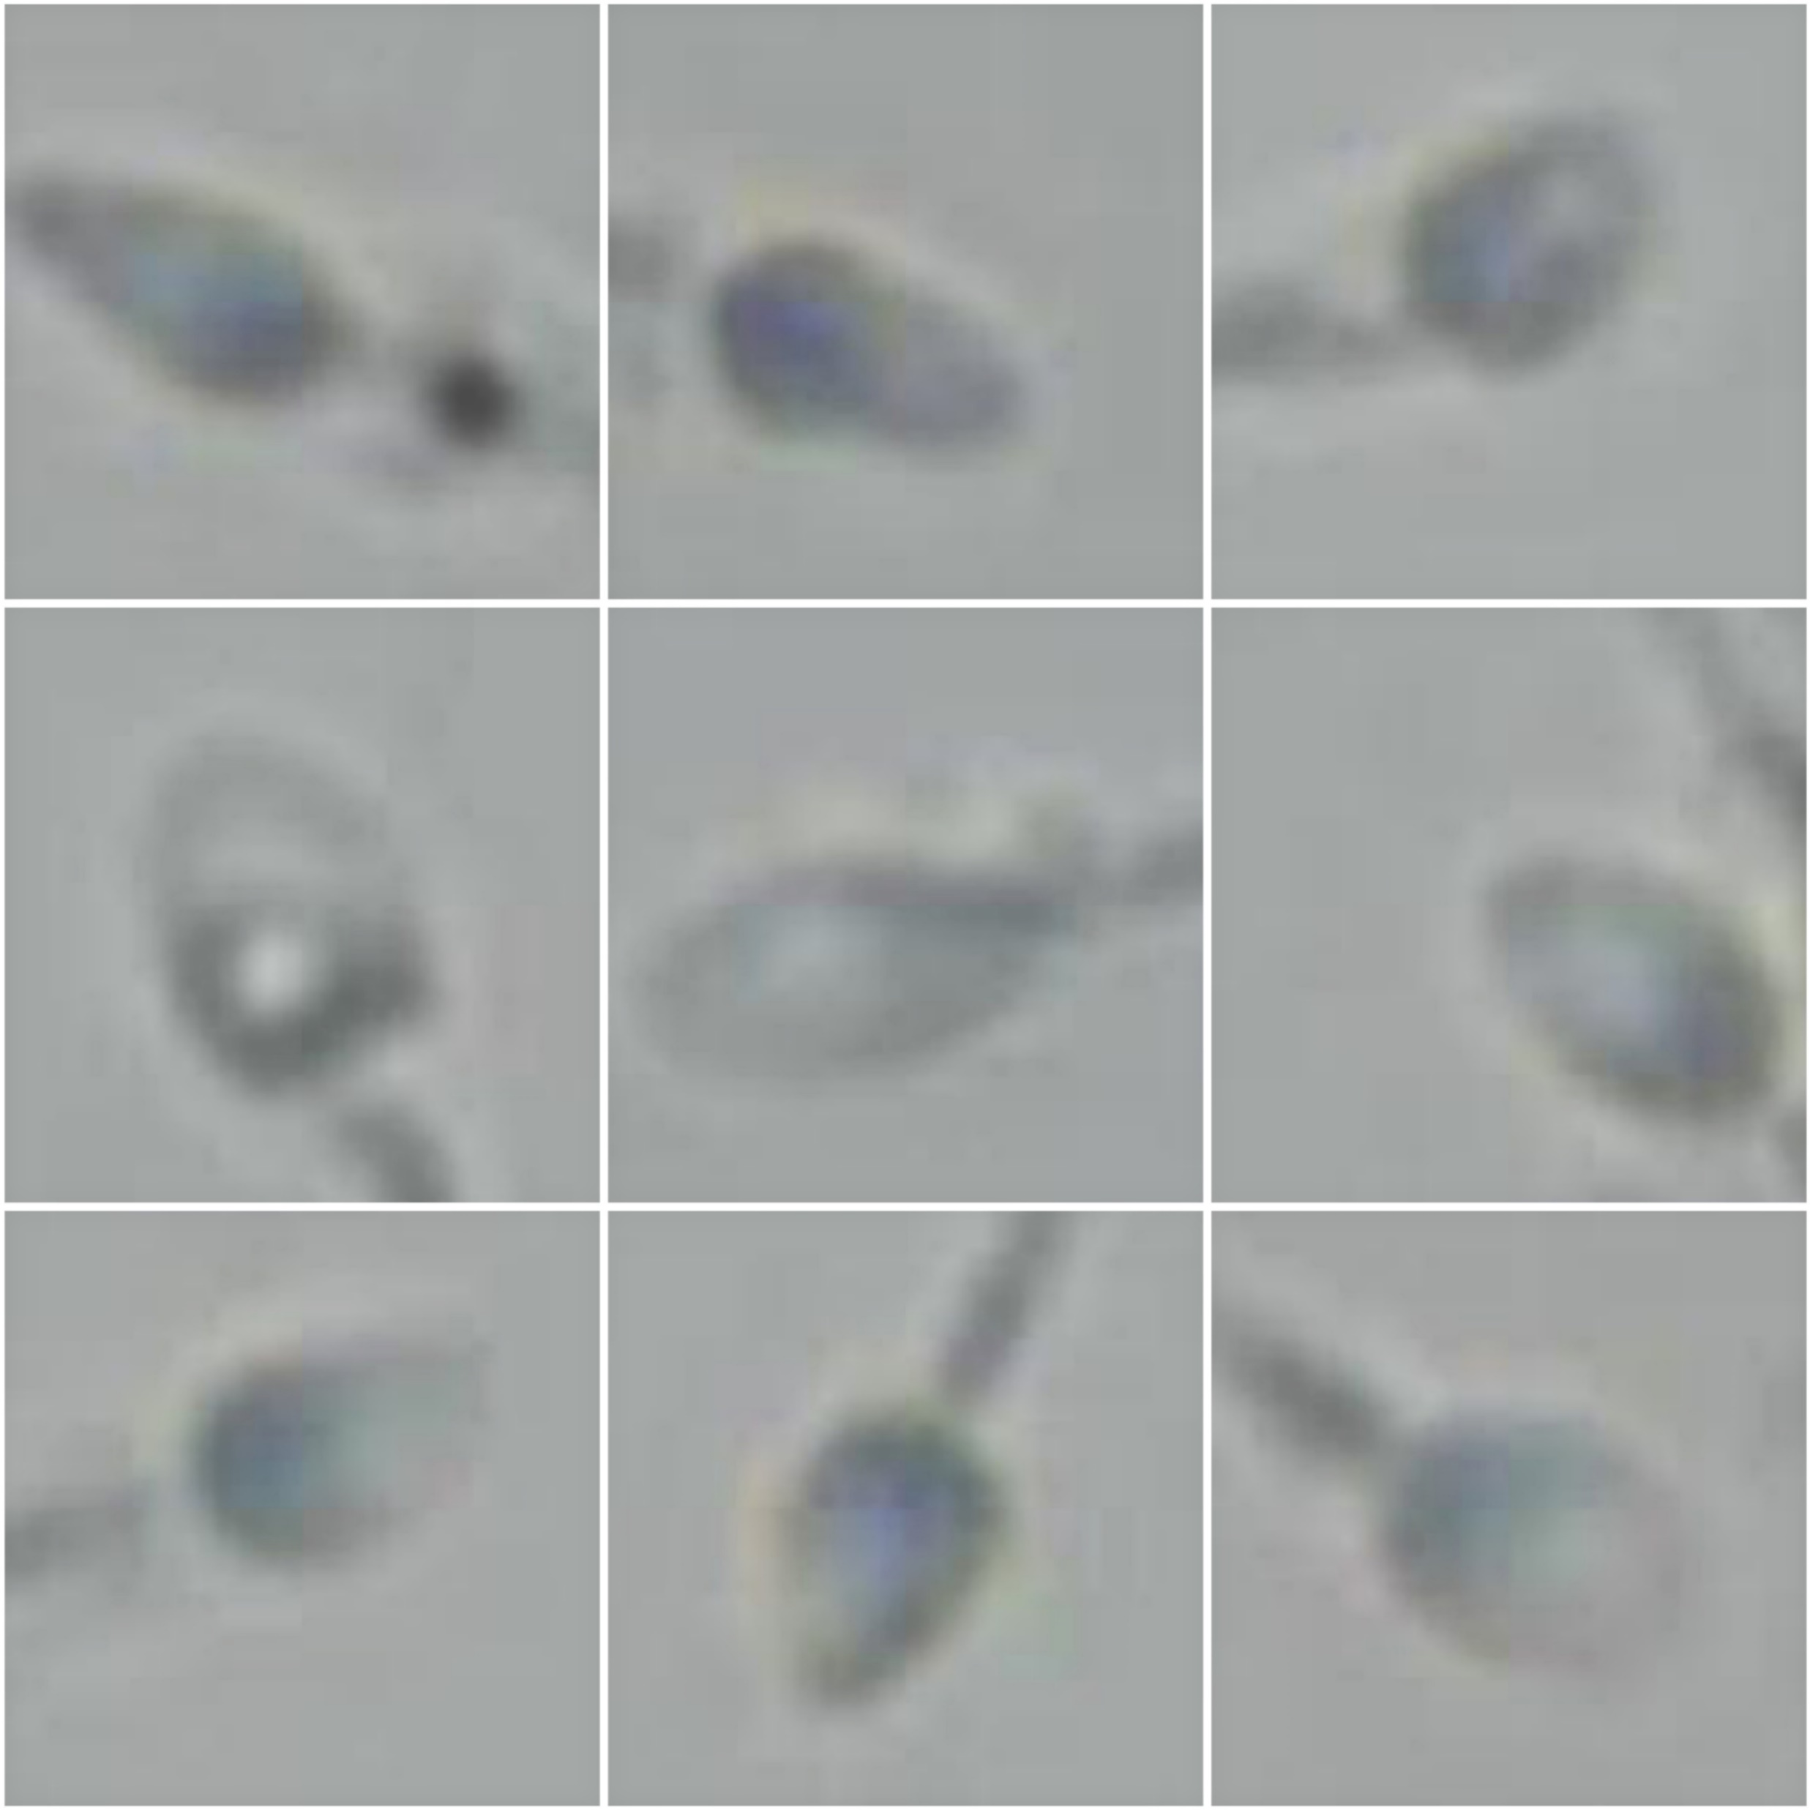
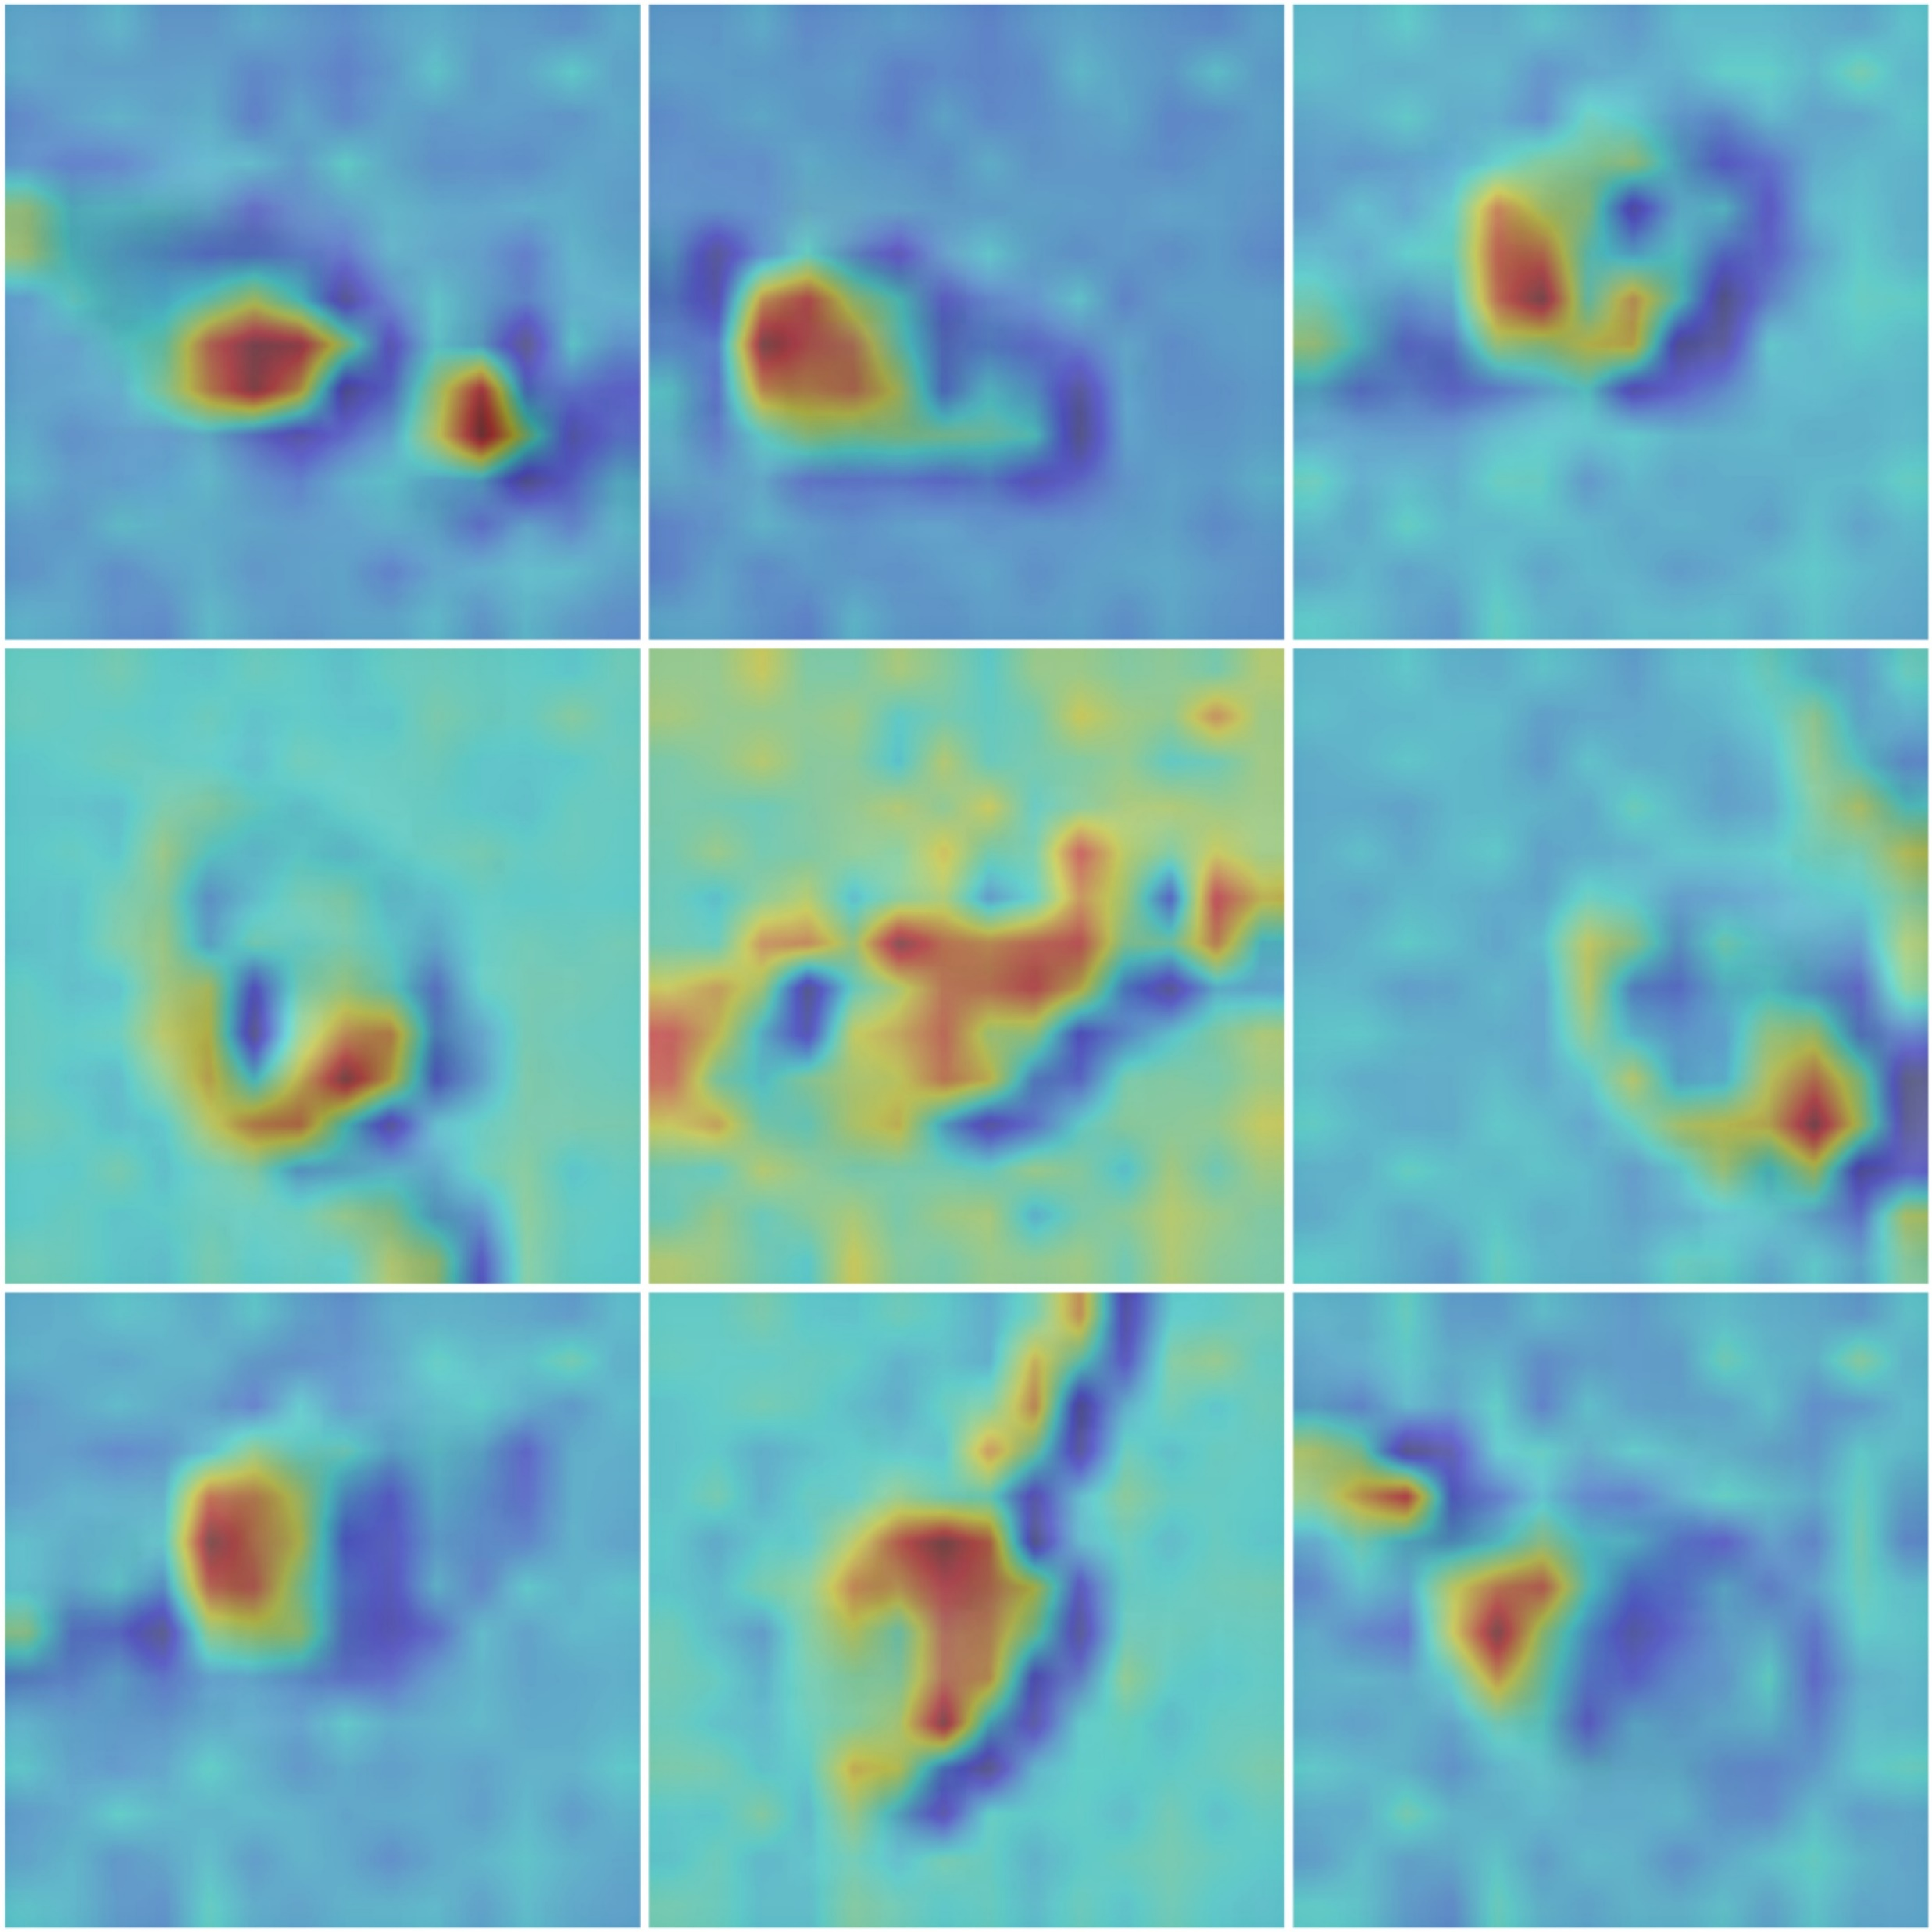
AI Model Pays More Attention to the Nucleus
All Live Sperm
Higher
Attention
Less
Attention
Dataset Collection
Model Training
Blind Testing

Slide 41
AI Model Pays More Attention to the Nucleus
All Live Sperm
All Dead Sperm
Higher
Attention
Less
Attention
For live sperm, the attention is more concentrated
Dataset Collection
Model Training
Blind Testing

Slide 42
Potential Application Scenarios

Slide 43
Application Scenario: Picking Live Sperm for NOA Patients in ICSI
Surgical Sperm Retrieval
TESA
TESE
PESA
MESE
Tedious
Repeated
Cycles
Failed to find a viable sperm
Dead
Hypo-Osmotic
Solution
Hypo-Osmotic
Solution

Slide 44
Application Scenario: Picking Live Sperm for NOA patients in ICSI
Surgical Sperm Retrieval
TESA
TESE
Vision Transformer
Model
PESA
MESE
Subsequent ICSI Treatments
Live Sperm 0.95
Finding a live sperm will be easier than ever

Slide 45
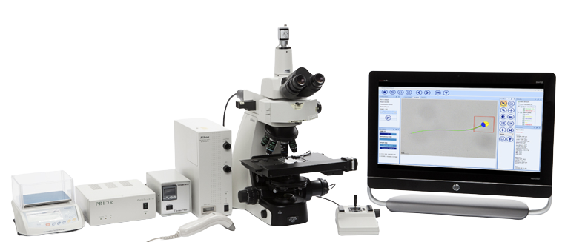
Application Scenario: Incorporating with CASA
Concentration
Morphology
Motility
CASA System
Image Source: Microptic S.L.
Instant Viability Result

Slide 46
Application Scenario: Incorporating with CASA
Concentration
Morphology
Motility
Vision Transformer
Model
Instant Viability Result

Slide 47
Summary
Proof-of-Concept
Microscopic images of sperm cells contain viability information
AI model (Vision Transformer) extracted such information
Accuracy: 94.9%
Attention on cell nucleus
Clinical trials are underway

